Slide 1

PROJECT ON DEVELOPMENT OF MOBILE APP FOR DIRECT FARMER – CUSTOMER ACCESS: ENHANCING PRICE NEGOTIATION AND EFFICIENCY
Under the Guidance of
G.Siva Sankar Varma
Associate Professor, Dept .of ECE, MRITM
PRESENTED BY
NAZMEEN BEGUM 217Y1A04F4
J.NIKHIL REDDY 217Y1A04F8
E.POOJITHA 217Y1A04F9
S.SANEETH REDDY 217Y1A04H0

Slide 2

CONTENT
PROBLEM STATEMENT
OBJECTIVES
SCOPE
LITERATURE SURVEY
FLOW CHART
ADVANTAGES
DISADVANTAGES
CONCLUSION
REFERENCES

Slide 3
PROBLEM STATEMENT
The mobile app connects farmers directly with customers, eliminating intermediaries in the agricultural supply chain.
It empowers farmers to sell their produce directly to consumers, improving their profits and ensuring fresh produce delivery to buyers.
Farmers often struggle with fair pricing due to intermediaries, and customers face challenges in sourcing fresh produce directly from local farmers.
The app aims to streamline the agricultural market, provide transparency in pricing, and ensure efficient logistics.

Slide 4
OBJECTIVES
Direct Access: Create a user-friendly platform that connects farmers directly with customers,eliminating intermediaries and enhancing market access.
Enhance Price Negotiation: Enable real-time communication and dynamic pricing options, allowing farmers and customers to negotiate prices effectively.

Slide 5
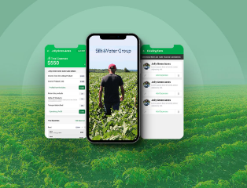
SCOPE
The scope of the project encompasses the development of a mobile application that connects farmers directly with consumers, facilitating real-time communication, price negotiation, and transparent transactions.
The project also aims to create a community-driven platform where users can share feedback, reviews, and agricultural best practices, fostering collaboration between farmers and consumers

Slide 6

LITERATURE SURVEY
The literature survey on the development of a mobile app for direct farmer-customer access reveals significant insights into the intersection of technology and agriculture.
Research shows that mobile technology enhances farmers' access to critical information, markets, and financial services, with successful case studies like mFarm in Kenya illustrating the benefits of direct communication between farmers and consumers.

Slide 7
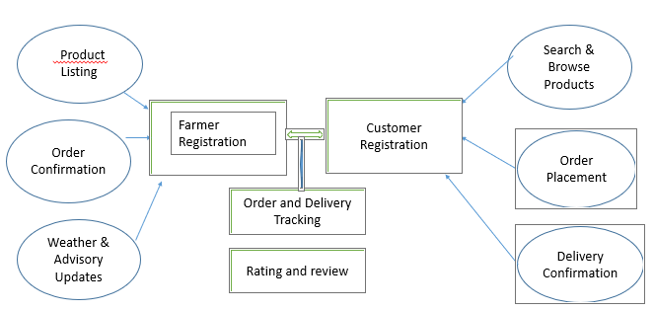
FLOW DIAGRAM

Slide 8
ADVANTAGES
Direct Access to Market
Real Time Pricing and Transparency
Efficient Logistics and Order Tracking
Secure Payments

Slide 9
DISADVANTAGES
Dependency on Intermediaries
Limited Market Reach
Lack of Price Control

Slide 10
CONCLUSION
Product Management: Farmers can list, update, and manage their products easily, while customers can browse and place orders.
Secure Payments: Integration of secure payment gateways (e.g., Stripe, Razorpay) for safe and transparent transactions.
Order Tracking: Real-time order and delivery tracking for both farmers and customers, ensuring timely and efficient deliveries.

Slide 11
REFERENCES
V. K. Gupta, S. Agarwal, and R. Sharma, "Development of an Online Marketplace for Agricultural Products", International Journal of Computer Science and Information Technology, 2022.
S. P. Sharma and A. D. Patel, "Mobile Applications in Agriculture: A Review of Platforms for Farmer-Customer Interaction", Journal of Agricultural Technology, 2023.
S. J. Sharma, P. Joshi, and R. K. Singh, "E-Commerce Platforms for Farmers: A New Approach to Agricultural Market Access", International Journal of Business and Agriculture, 2024.
M. S. Agarwal and R. R. Bhagat, "The Role of Digital Technology in Empowering Farmers and Connecting Them with Consumers", Agricultural Technology and Innovation, 2023.
**R. Sharma, "Mobile App for Direct Market Access for Farmers", Conference on Agriculture Technology and Modern Solutions, 2023

Slide 12


